Slide 1
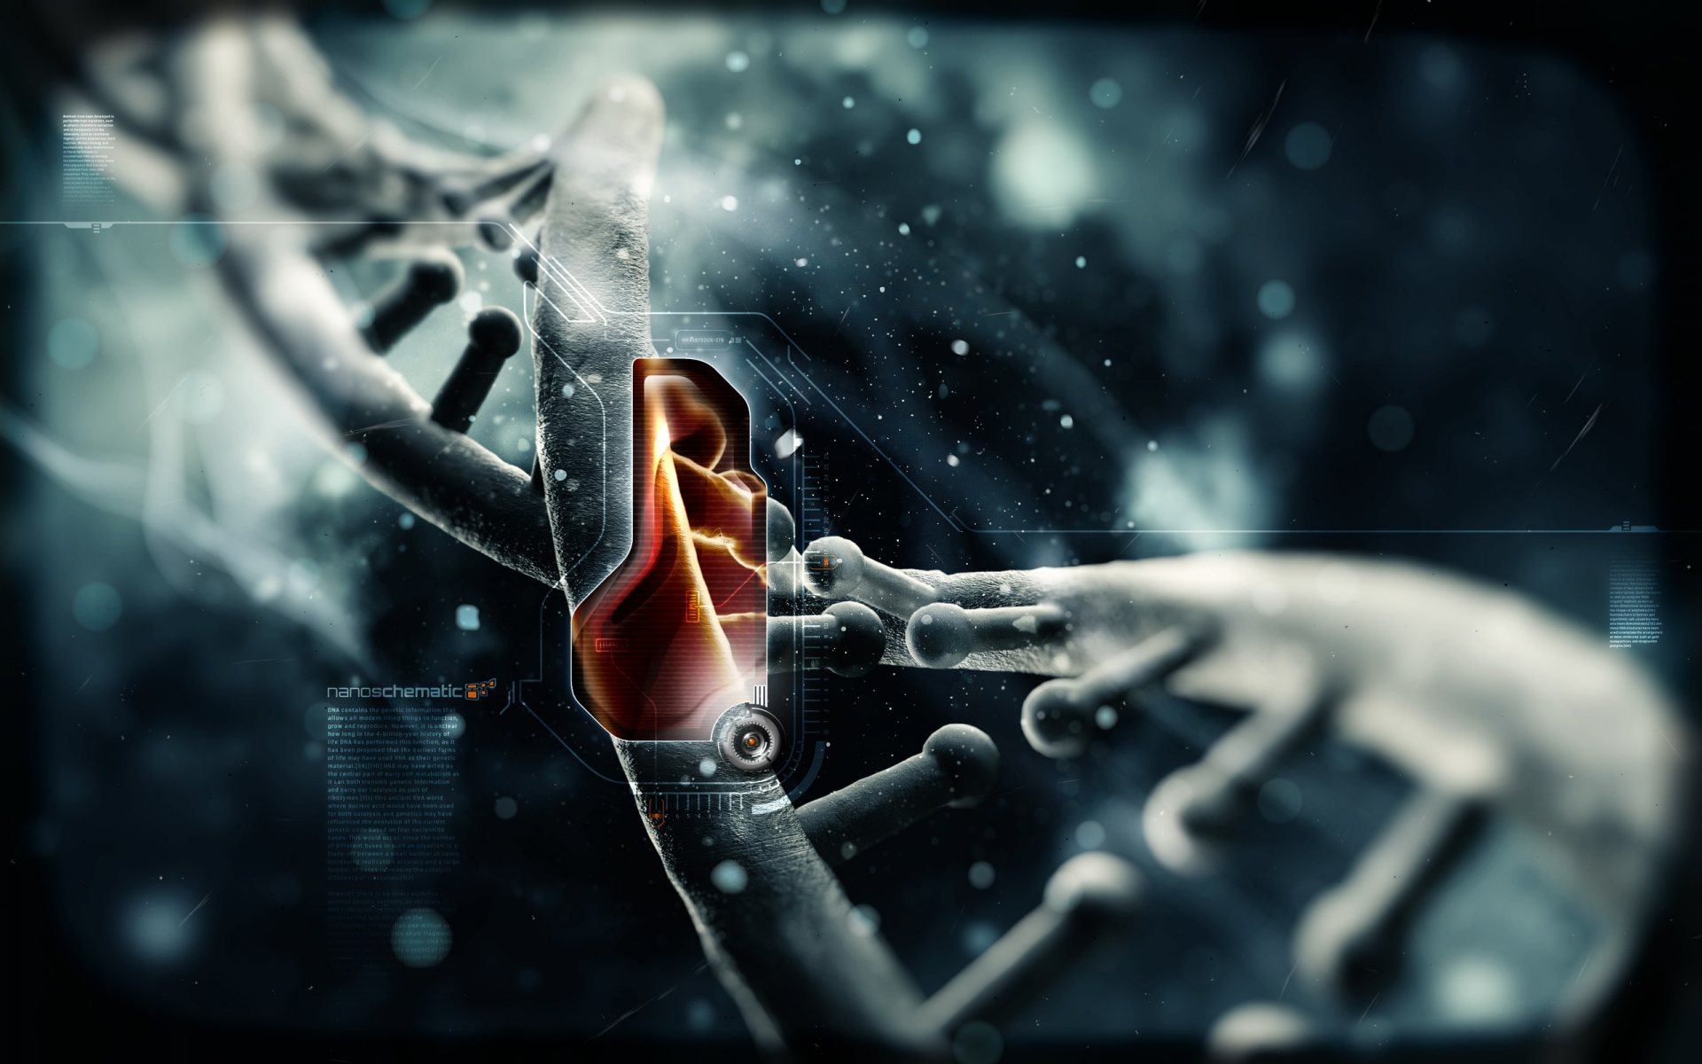
Moletronics
Presented by
CH Sumanth
13SS1A0410

Slide 2
CONTENTS
INTRODUCTION
BRIEF HISTORY
MATERIALS USED IN MOLETRONICS
MOLECULAR ELECTRONICS COMPONENTS
CHARACTERISTICS OF MOLECULAR DEVICES
ADVANTAGES AND ROADBLOCKS
APPLICATIONS
FUTURE DEVELOPMENTS

Slide 3
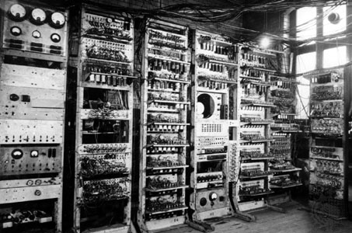
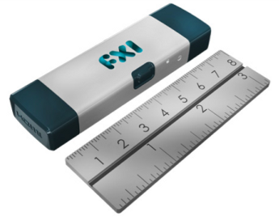
INTRODUCTION
Latest computer
First computer

Slide 4
MOORE’S LAW
Moore’s law states that
“The number of transistors per square inch on integrated circuits will double every year.”

Slide 5
Different scales of Silicon Integration Technology
SSI (small scale integration)-1-12 gates on a single chip
LSI (large scale integration)-30-300 gates on a single chip
VLSI (Very large scale integration)-300-10000 gates on a single chip
MSI (medium scale integration)-12-30 gates on a single chip
ULSI (ultra large scale integration)-beyond 10000 gates on a single chip

Slide 6
WHAT AFTER ULSI
IS IT THE END
??????
MOLETRONICS

Slide 7
MOLETRONICS
“It is branch of electronics in which individual molecules perform in same function as microelectronics devices such as diode or transistors.”
OR
“Moletronics is a subset of nanotechnology dealing with the manipulation of molecules so they work together as electronic circuits.”
MOLECULE
ELECTRONICS
MOLETRONICS

Slide 8
MATERIALS USED IN MOLETRONICS

Slide 9
MATERIALS USED IN MOLETRONICS
POLYPHENYLENE BASED CHAINS
Chemical formulae (C₆H₅) _{x}
Highly flexible
Capable of carrying and switching currents.
Very high current density(~.5 million times of Copper wires)
Used as molecular wires and switches.

Slide 10
MATERIALS USED IN MOLETRONICS
CARBON NANOTUBES
Used as molecular wires or “Bucky tube”.
High conductivity when used on micro patterned semiconductor surface ranging from excellent conduction to pretty good insulation..
Differ in diameters and chirality
Chemically stable but made only under extreme conditions

Slide 11
MOLECULAR ELECTRONIC COMPONENTS

Slide 12
MOLECULAR TRANSISTORS
Consists of 3 benzene rings
Centre ring has asymmetric fragments
Great flexibility and can even function when it is bent.

Slide 13
Molecular Diodes
Rectifying Diodes
Also called molecular rectifier
Allows current flow in only one direction
Resonant tunneling Diodes(RTDs).
Current flow in both directions
Uses electron energy quantization

Slide 14
CHARACTERISTICS OF MOLECULAR DEVICES
Nonlinear I-V Behavior
Energy Dissipation
Gain in Molecular Electronic Circuits
Speed

Slide 15
Advantages of Molecular Electronics
Size
Speed
Assembly
Low Manufacturing Cost
Able to integrate large circuit
Synthetic flexibility/Re-configurable.
Streochemistry
Greater memory hold time

Slide 16
MOLETRONICS ROADBLOCKS
Hard experimental verification
Controlled fabrication within specified tolerances

Slide 17
APPLICATIONS
Molecular Sensors
Molecular tweezers
Molecular Switch
Molecular Motors
Logic and memory devices
Smart Fabrics

Slide 18
FUTURE DEVELOPMENTS

Slide 19
MEMORY STORAGE APPLICATIONS
Data storage is done by multiporphyrin nanostructures into electronic memory.
The application of a voltage causes the molecules to oxidize, or give up electrons.
The molecules then retain their positive charge after the electric field is removed, producing a memory effect.

Slide 21
MEMORY HOLD TIME
Silicon memory devices = 1 milli sec
Moletronic device = 15 min
So less power

Slide 22
CONCLUSION
“The Next Big Thing is very, very small. Picture trillions of transistors, processors so fast their speed is measured in terahertz, infinite capacity, zero cost. It's the dawn of a new technological revolution - and the death of silicon.”

Slide 23
REFERENCES
Scientific forum http://www.calmec.com/scientif.htm
Search http://www.calmec.com/search.htm
www.ieee.org
Strategic Technologies for the Military: Breaking New Frontiers By Ajey Lele
http://technews.acm.org/articles/2002-4/0805m.html
http://www.wikipedia.com

